Slide 1
Developing Airline Information Application
Exploring Components, Filters, and Search Functionality

Slide 2
Project Objectives
Developing a dynamic application to display and filter airline information using React.
Utilizing components such as Card, SearchBar, and Filter.

Slide 3
Card Component
Represents individual airline information in a card component.
Displays logo, name, alliance, phone, and website information.
Additional details appear on user hover.

Slide 4
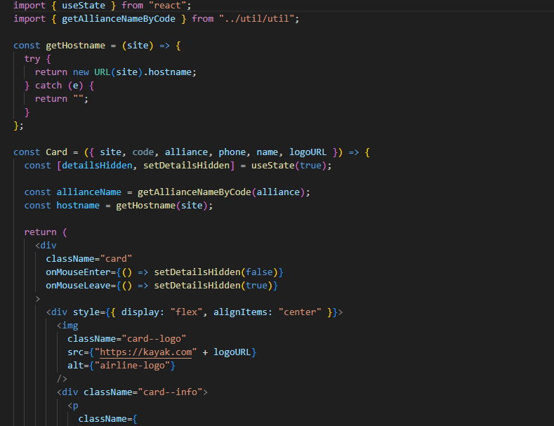

Slide 5
SearchBar Component
Implements a search bar for filtering airlines based on their names.
Manages search term using React state.

Slide 6
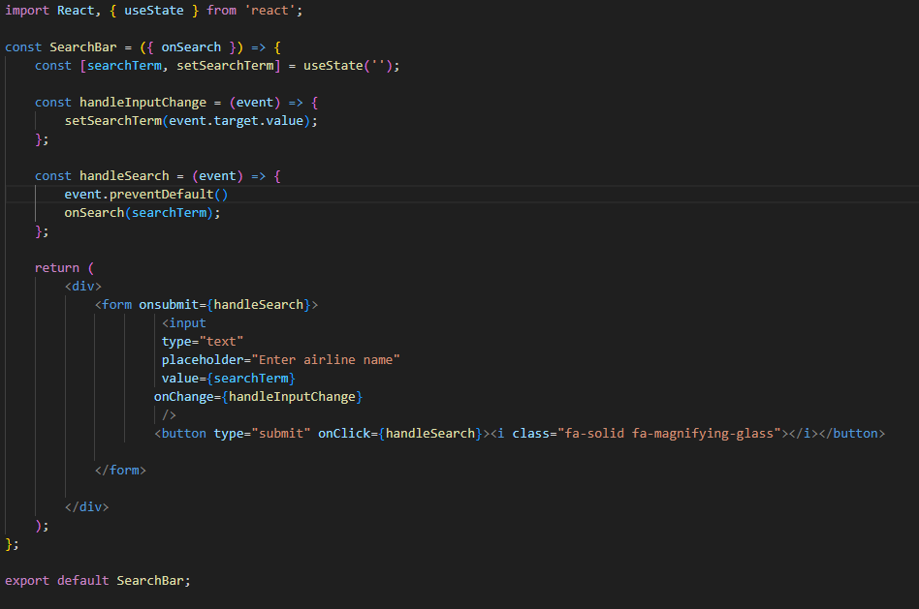

Slide 7
Filter Component
Provides functionality to filter airlines based on their alliances.
Manages selected filters using React state.

Slide 8
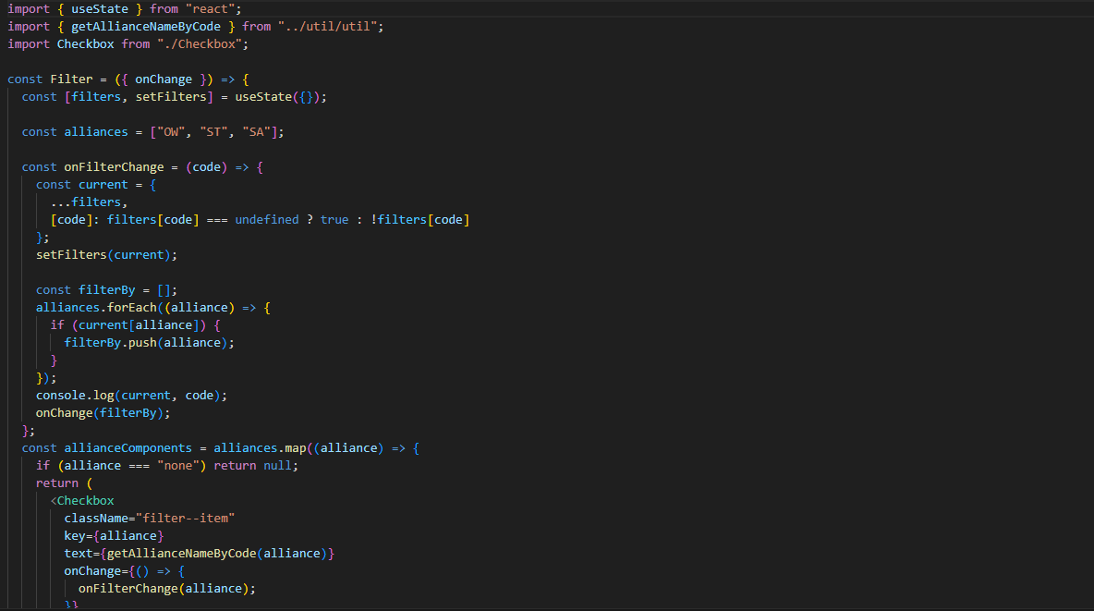

Slide 9
Airlines Component
Asynchronously retrieves airline data from an external API using the useEffect hook.
Dynamically filters data based on alliances and search terms.

Slide 10
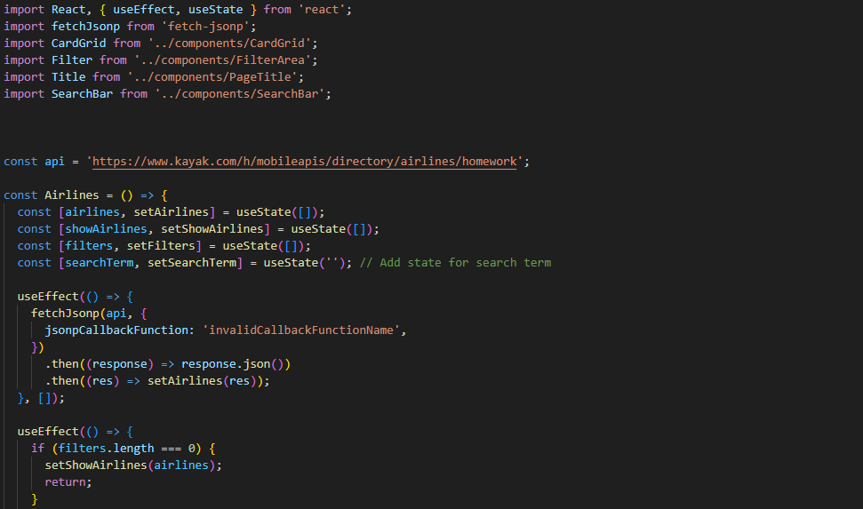

Slide 11
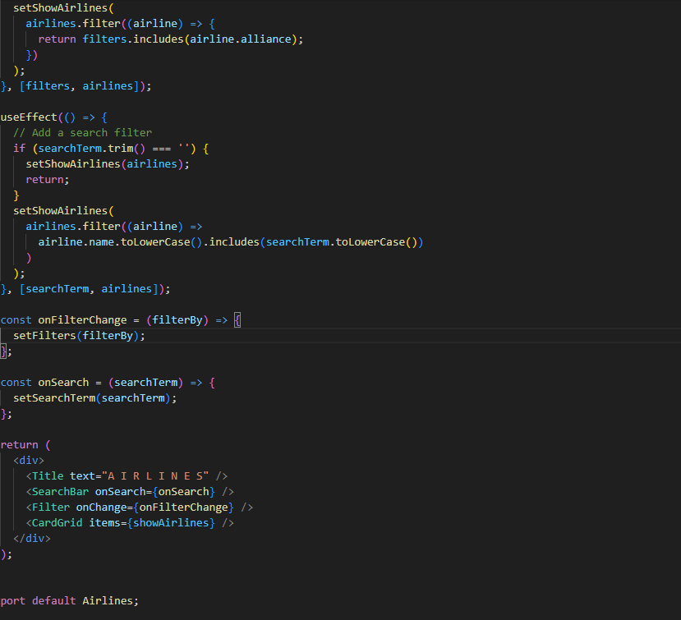

Slide 12
Application Structure
Illustrates the main structure of the React application.
Main container includes TitleBar and Airlines components.

Slide 13
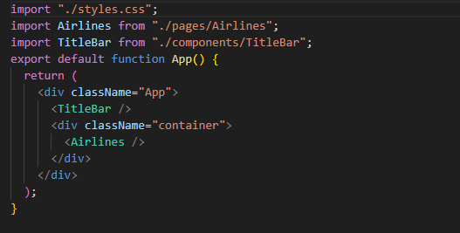

Slide 14
Conclusion
Implemented a dynamic application to display airline information using React.
Technical understanding of the roles and interactions of each component.
Leveraged powerful features of React as evident in the code.

Slide 15
THANK YOU
GitHub URL for this project:
https://github.com/khasanlee/WP_PROJECT

